Slide 1
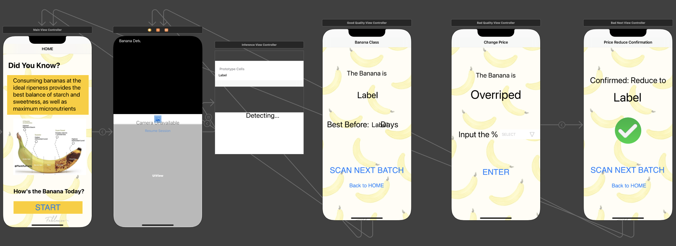
Banana Ripeness Classifier (IOS app)

Slide 2
Agenda
0
Problem Statement
Significance-Why this problem
Past projects - Literature Review
Methodology – ML Canvas
Model Benchmarking
Model Deployment
Demo
Q&A
Notes:
Dataset description:

Slide 3
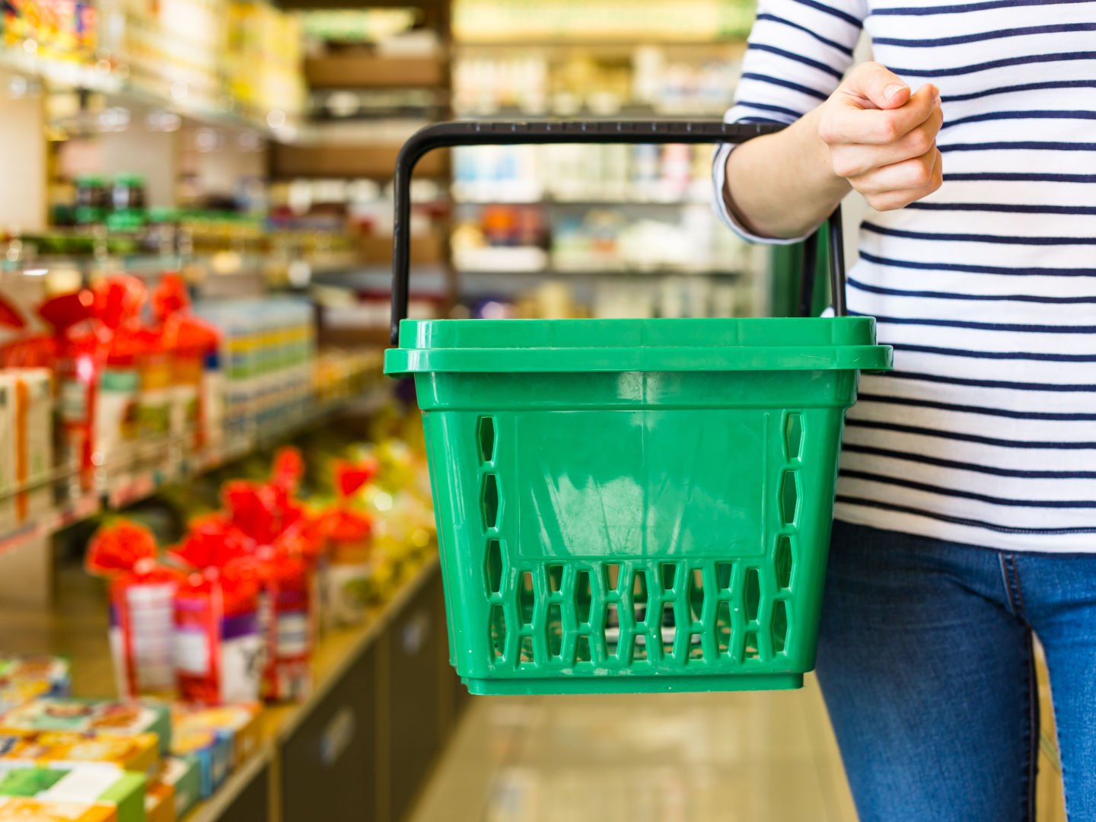
Problem Statement
Walmart is committed to reducing food waste and improving sustainability in its operations. However, the high amount of banana waste generated in its North American stores is not only a significant financial cost but also harmful to Walmart's brand image.
Despite efforts to reduce waste, inaccurate assessments of banana ripeness result in a large amount of waste that cannot be donated or repurposed.
This sends a negative message to customers, who are increasingly conscious of companies' environmental impact and sustainability efforts.

Slide 4
Significance-Why this problem
In North America, it is estimated that 22% of bananas are wasted, which amounts to approximately 4.4 billion pounds of bananas per year.
The economic cost of food waste in North America is estimated to be $50 million per year, which includes costs associated with production, transportation, disposal, and other factors.
In addition to the economic impact, food waste also has a significant environmental impact. According to the World Wildlife Fund, food waste is responsible for 8% of global greenhouse gas emissions.
Bananas are one of the most commonly wasted fruits due to their short shelf life and susceptibility to overripeness. This is a significant issue for retailers such as Walmart, which must dispose of large amounts of overripe bananas each year at a significant cost.
It is estimated that millions US dollar of cost saving and additional revenue could be generated by by these bananas every year.

Slide 5
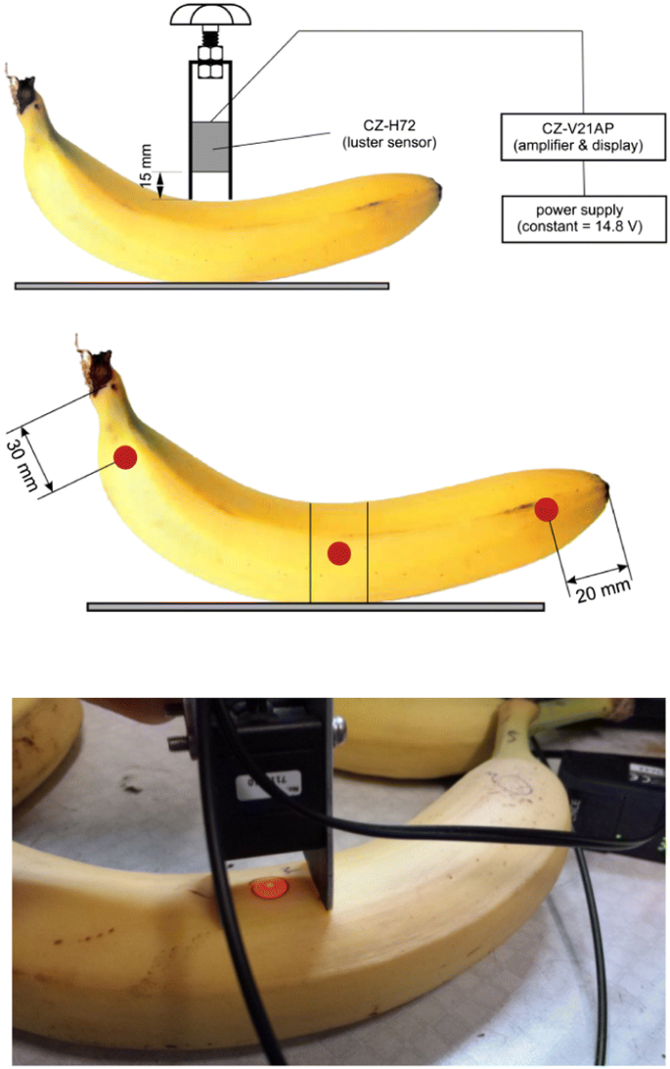
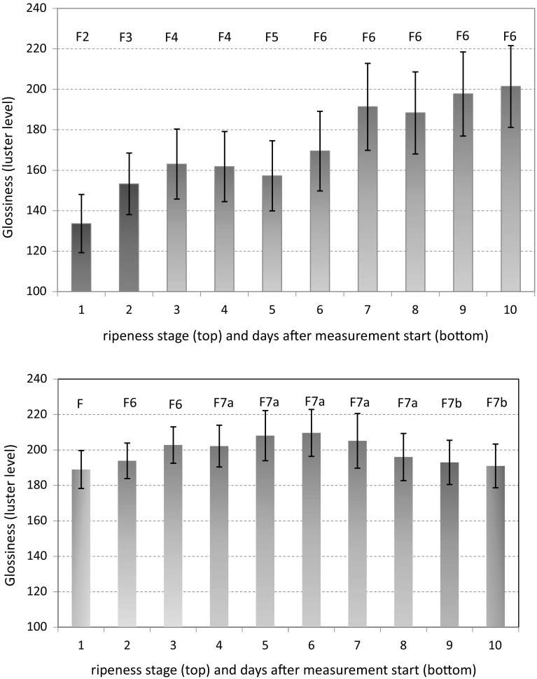
Past projects - Review
Non-invasive determination of surface features of banana during ripening
Draw Backs
Mainly limited to glossiness and colors
Extensive Hardware equipment
Require manual calibration and adjustment for different varieties or environmental conditions
Reference to: https://www.ncbi.nlm.nih.gov/pmc/articles/PMC6133831/

Slide 6
ML Canvas
Prediction Task:
Building an image classification for banana ripeness
We detect the banana ripeness level and set it to four stages
The outcomes are Underriped, Barely riped, Riped, Overriped
The total training time is about 12 mins, each model with 20 epochs
Impact Simulation:
Saved the model to h5, converted the h5 file to tf lite, deployed tf lite to java, and ran it on a mobile application
Used the valid, test set and real-time mobile application to evaluate the performance, with outstanding more than 80% accuracy
Increase gross margin on bananas by 5%
Increase 30% sales volume of almost-ripened banana

Slide 7
ML Canvas
Data Collection:
Updated the initial dataset by using Python and data augmentation
Split the dataset with 70% training, 20% testing, and 10% validation
Since we use Xception as our classification network, we need high-performance computing resources to compute the outcomes
Allow to deploy the final model on CCTV and the variety of systems
Data Sources:
Got the banana ripeness dataset from roboflow
Used roboflow API to collect and separate to train, test, valid, and different classes

Slide 8
ML Canvas
Building Models & Features:
One model for one product(e.g. Apple, orange, and Kiwi)
Not required to update most of the products frequently
The input representations can be any banana images under different backgrounds and situation
Prediction time is instant

Slide 9
ML Canvas
Decisions, Value Proposition & Making prediction
End-user: Walmart warehouse
Objective: Real-time predict the banana ripeness to have better inventory management
Optimize the inventory level and reduce the chance of overstocking
Reduce waste, expand and improve our brand image
Monitor
Metrics: Accuracy and loss

Slide 10
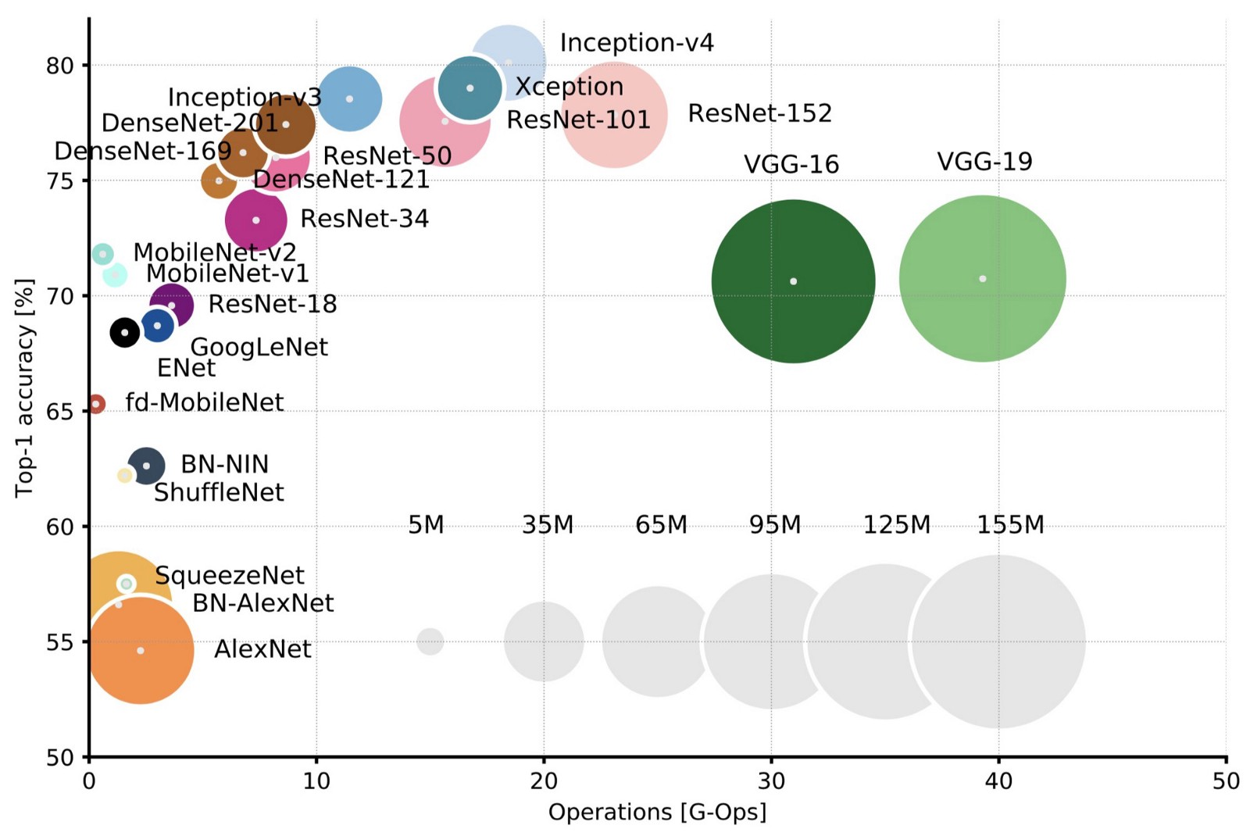
Model Benchmarking
Xception architecture allows to optimise both accuracy and number of parameters of the model.
Reduce the difficulty and time to train a mature model
Outstanding performance

Slide 11
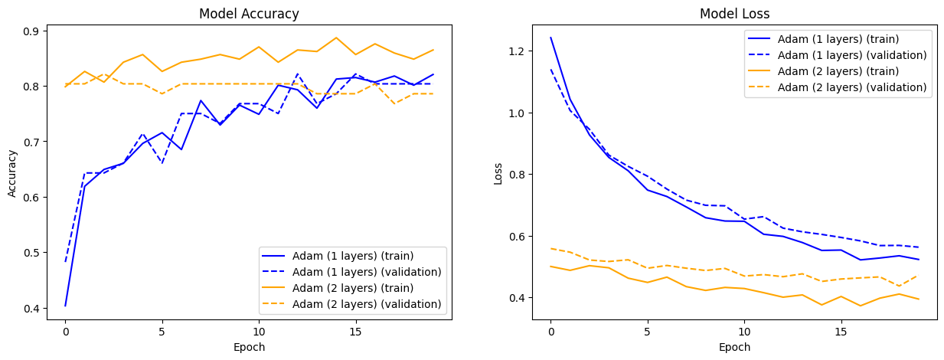
Model Benchmarking
The validation accuracy achieves to more than 80%, aligned with state-of-the-art Xception model.

Slide 12
Model Deployment
Feature | Docker | Xcode 🏆
Development Environment | ❌ Requires a separate development environment to be set up and maintained | ✅ Provides a comprehensive development environment specifically designed for iOS app development
Integration with Cloud Platforms | ❌ Requires additional configuration and tools to integrate with cloud platforms | ✅ Integrates with various cloud platforms, including AWS, Azure, and GCP
CI/CD Support | ❌Requires additional configuration and tools to set up CI/CD pipelines | ✅Provides built-in support for CI/CD, allowing you to easily automate the process of building, testing, and deploying your iOS application
External Library and Dependency Management | ❌ Requires additional configuration and tools to manage external libraries and dependencies | ✅ Provides easy integration with external libraries and dependencies, making it easy to add new features and functionality to your iOS application
Overall Complexity | ❌May add additional complexity to the development and deployment process | ✅ Provides a streamlined and efficient development and deployment process for iOS applications

Slide 13

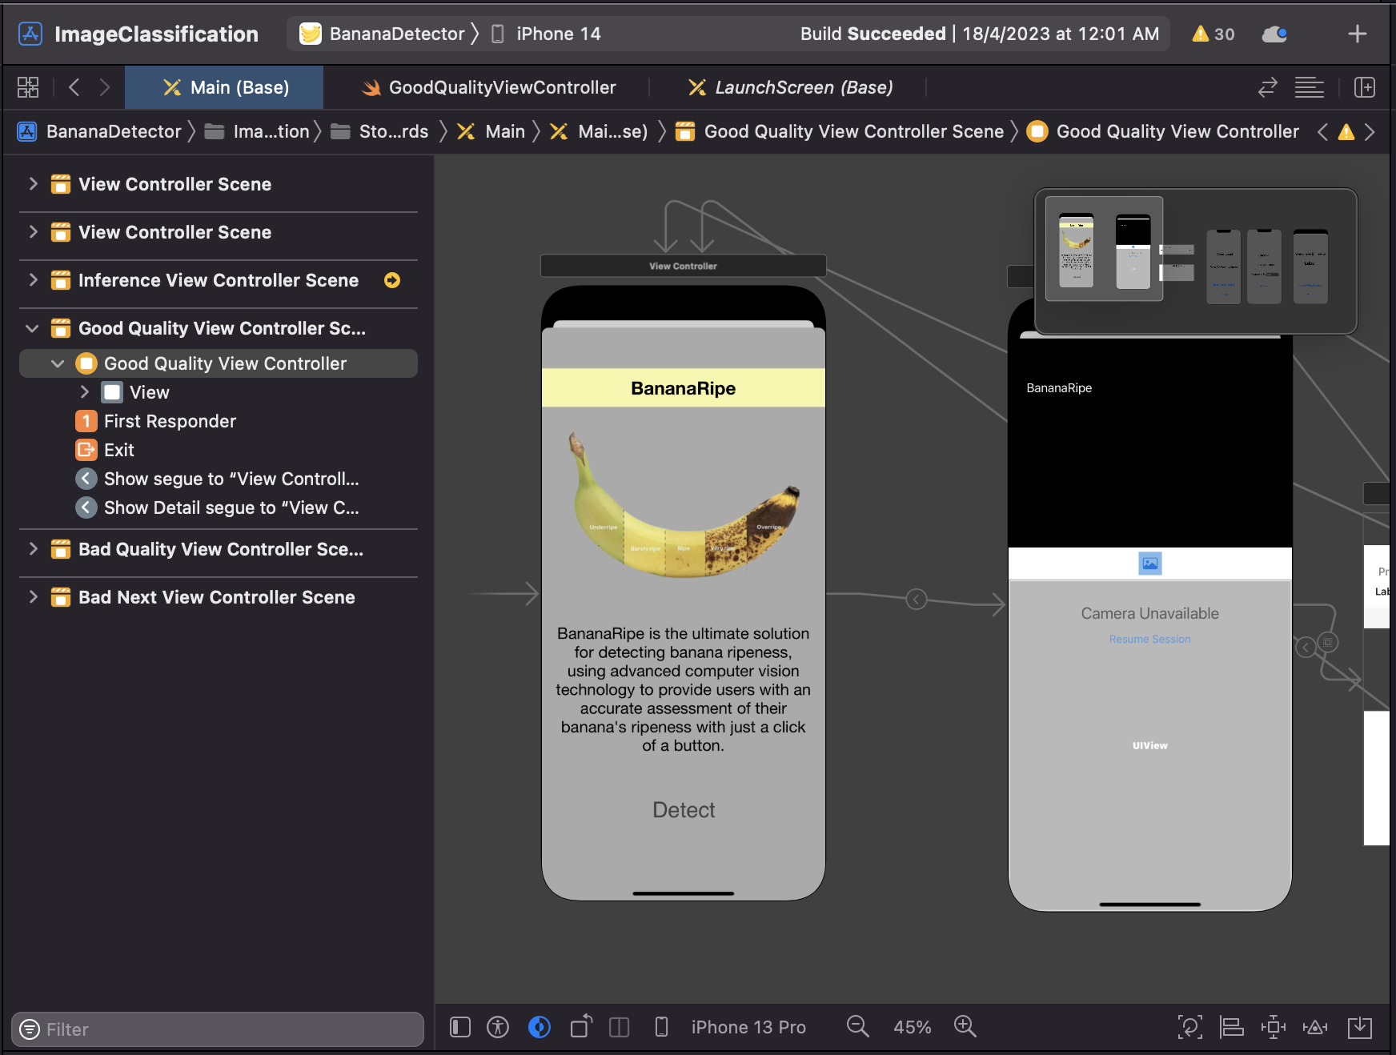
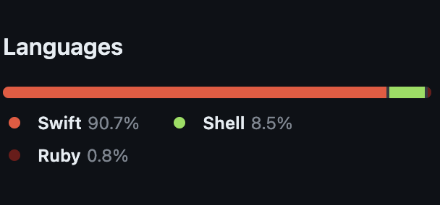
Model Deployment
Deploying Machine Learning Models in iOS Applications
Language and Tools Used
Ready the UX/UI

Slide 14
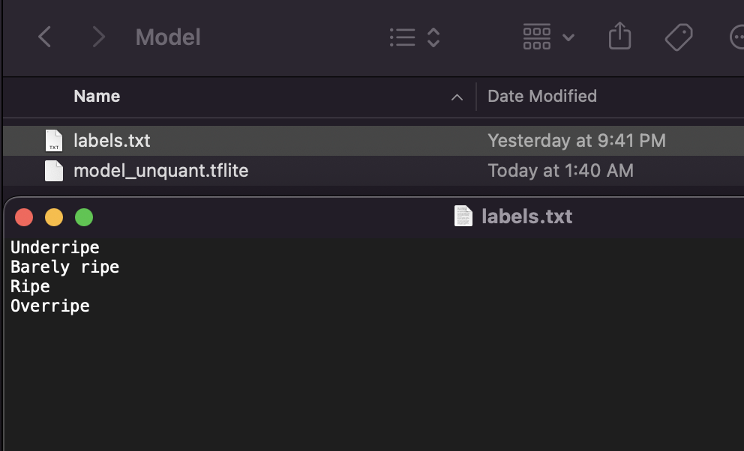
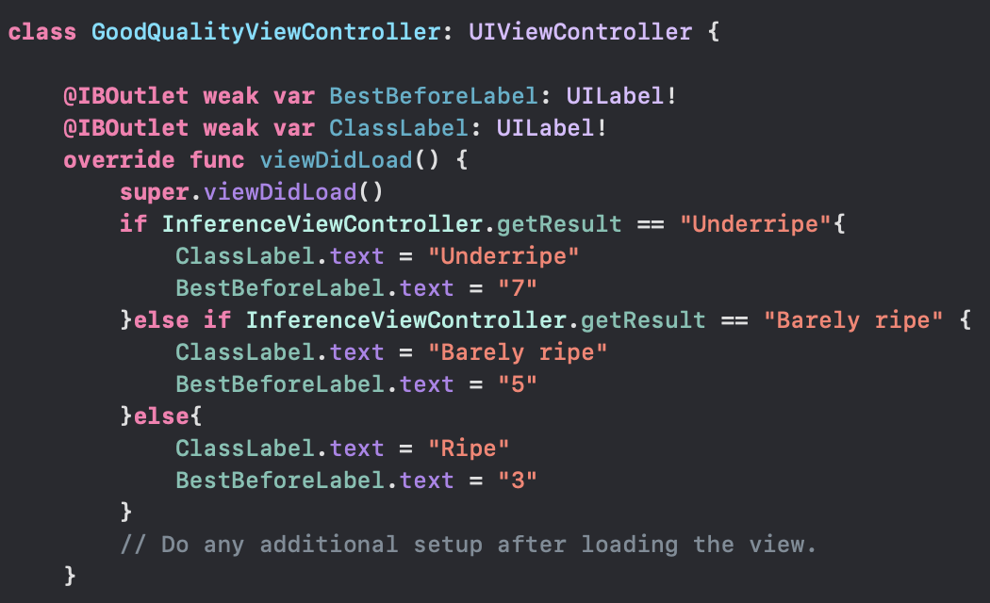
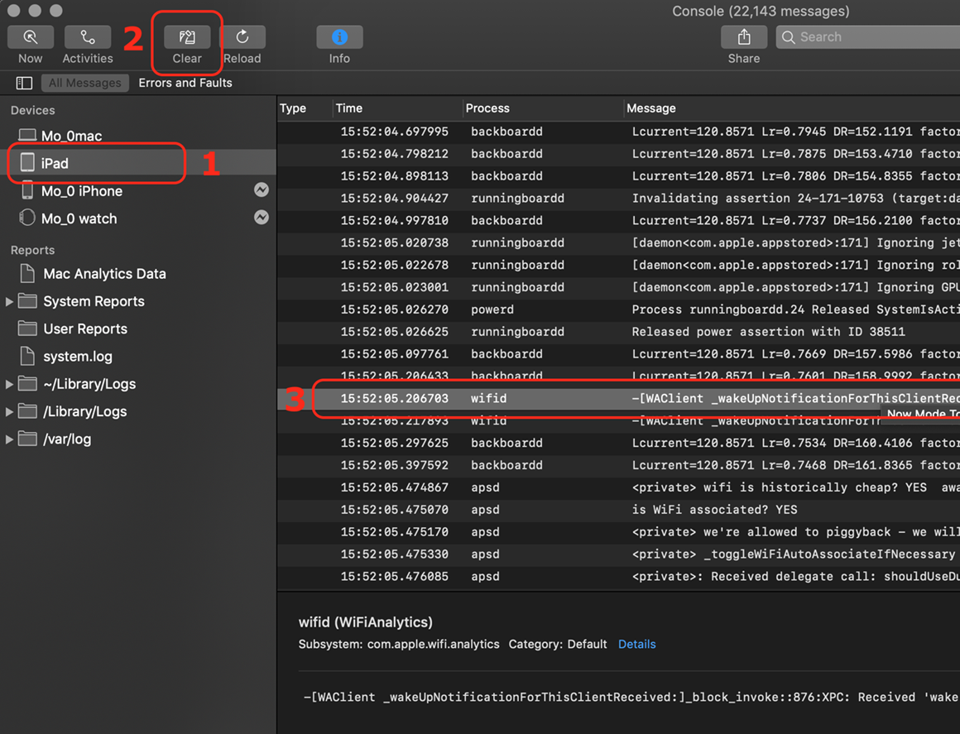
Model Deployment
Prepare the model
Convert to .tflite format
Integrated into our User Interface (UI) code.
Testing and Monitoring by logging tools

Slide 15
Challenges & Issues encountered
Challenge 1: The challenge of collecting high-quality images with diverse backgrounds
Solution 1a: Data augmentation techniques have been applied to increase the variety of images and reduce the risk of overfitting
Solution 1b: Transfer learning has also been utilized to minimize the required training resources and time.
Challenge 2: The challenge of deploying the model to a user-friendly base
Solution 2: The model has been deployed on the iOS platform to make it accessible to a wider audience. Also, edge-computing allows real-time and offline running, instead of deploying with cloud

Slide 16


Demo

Slide 17
Q & A

Slide 18
Thank you

